Slide 1

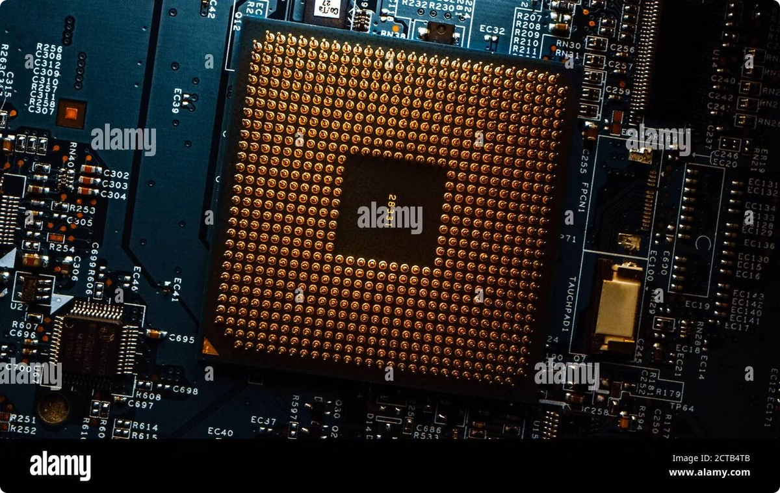

Unveiling the Core: CPU and Motherboard
Explore the central components of a computer system.
by Rashidul Islam Zidan

Slide 2

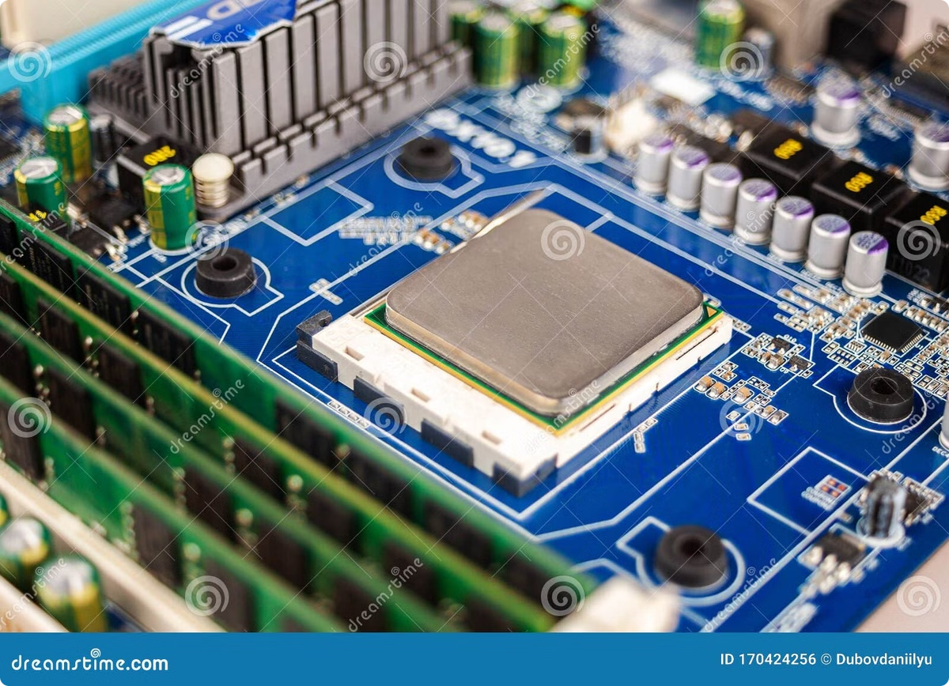
The Brain: CPU
1
Processing Powerhouse
Executes instructions, performs calculations.
2
Clock Speed
Measured in GHz, dictates processing speed.
3
Cores
Multiple cores enable parallel processing.

Slide 3
Motherboard: The Foundation
Connectivity Hub
Expansion Slots
Form Factor
Connects all computer components.
Allow for adding components like GPUs.
Determines case compatibility.

Slide 4

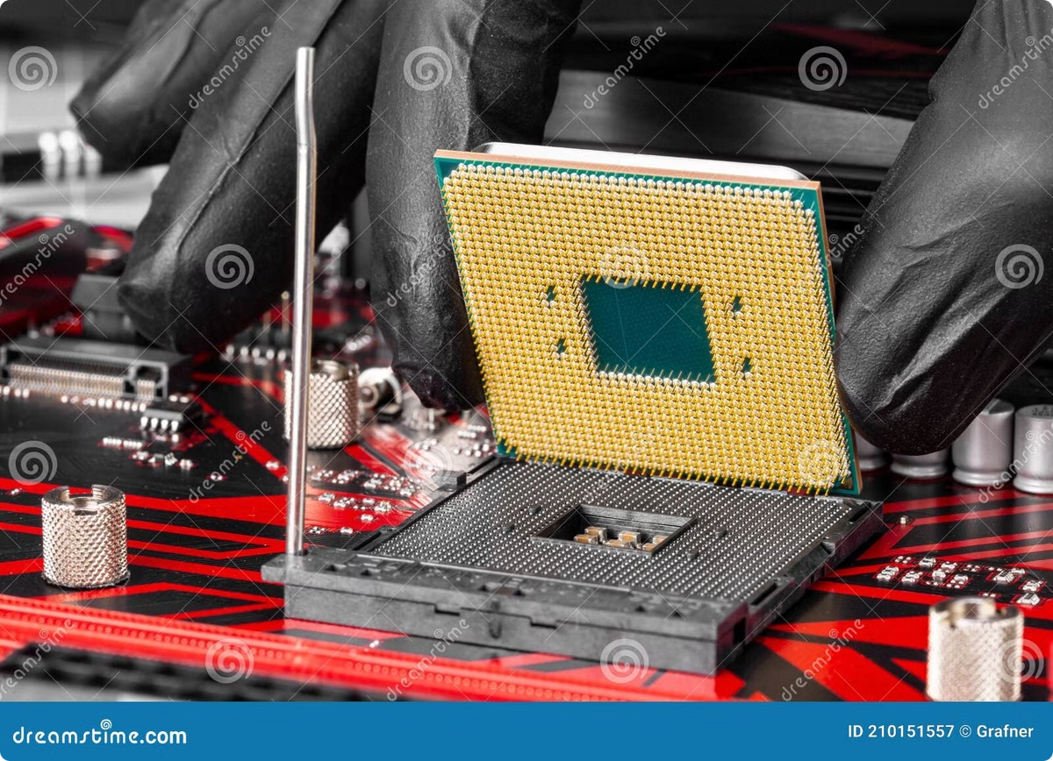
CPU Socket
Physical Interface
Houses the CPU on the motherboard.
Compatibility
Specific sockets support certain CPUs.
Installation
Requires careful alignment and locking.

Slide 5
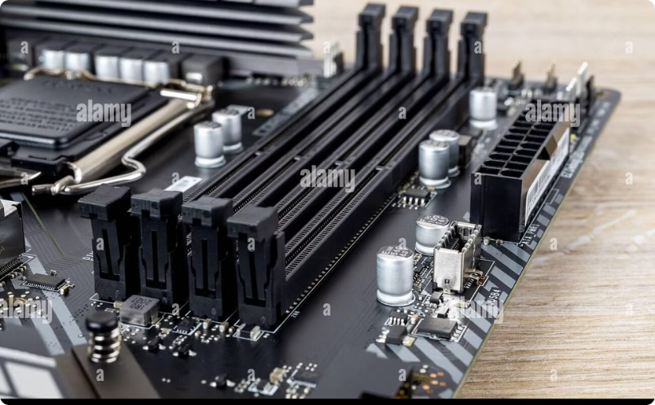
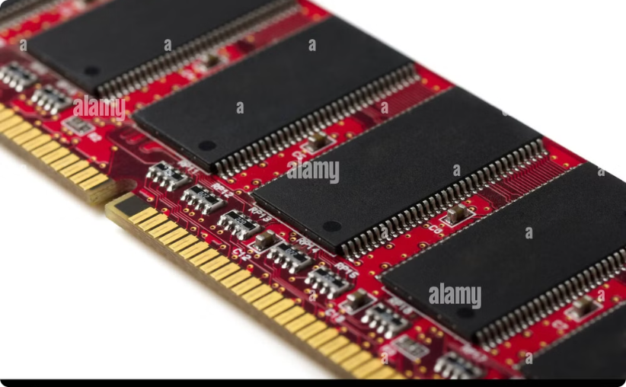
RAM: Short-Term Memory
Data Accessibility
Types and Speeds
Provides fast access for running programs.
DDR4 is a common standard, speed in MHz.

Slide 6

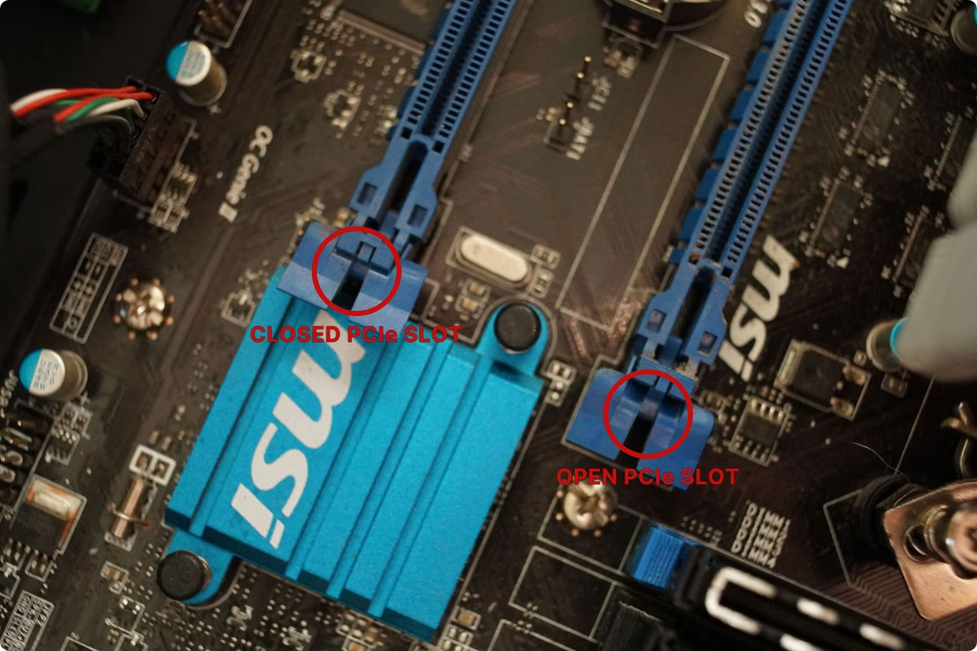


Expansion Slots: Enhancing Capabilities
PCI Express (PCIe)
For high-speed components like GPUs.
Other Legacy Slots
May include PCI, AGP for older devices.

Slide 7

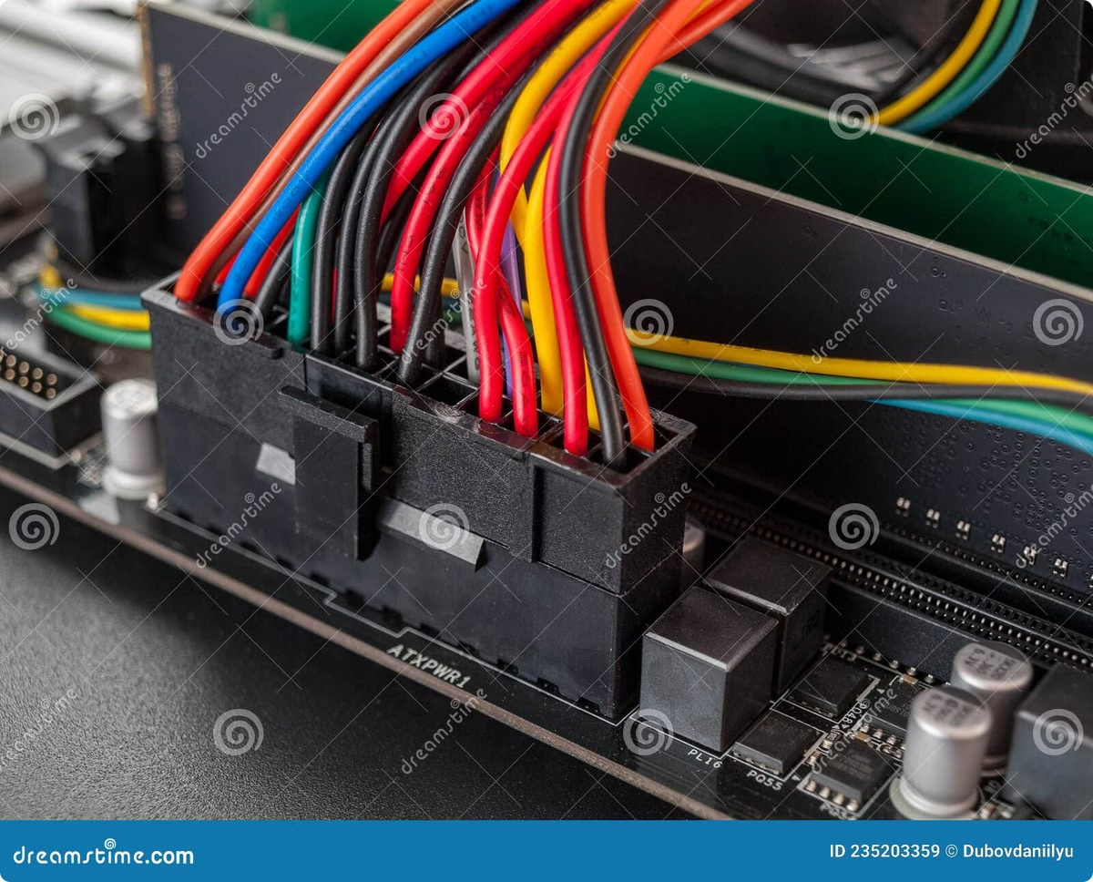
Power Supply Connection
1
Power Delivery
Supplies power to the motherboard.
2
Voltage Rails
Provides different voltages for components.
3
Wattage Rating
Determines the power output capacity.

Slide 8


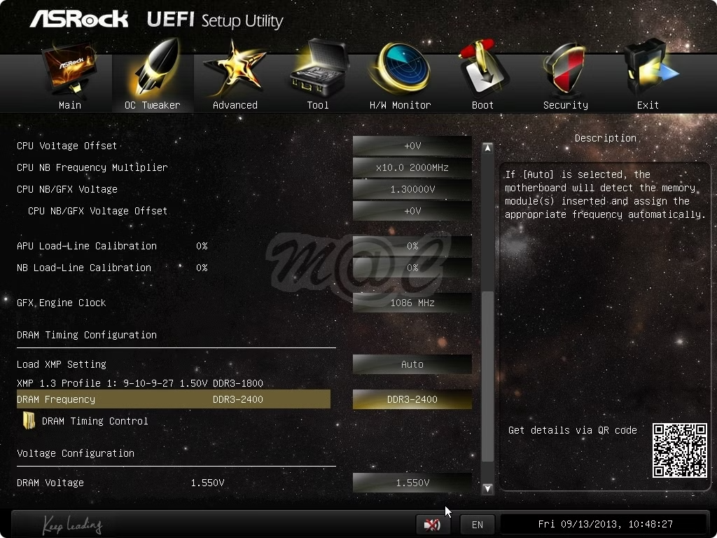


BIOS and CMOS
BIOS Chip
Stores boot instructions.
CMOS Battery
Powers the CMOS memory.
System Settings
Allows for configuration changes.

